Slide 1
Qíngrénjié 情人节 (情人節)
2 14
月 号

Slide 2
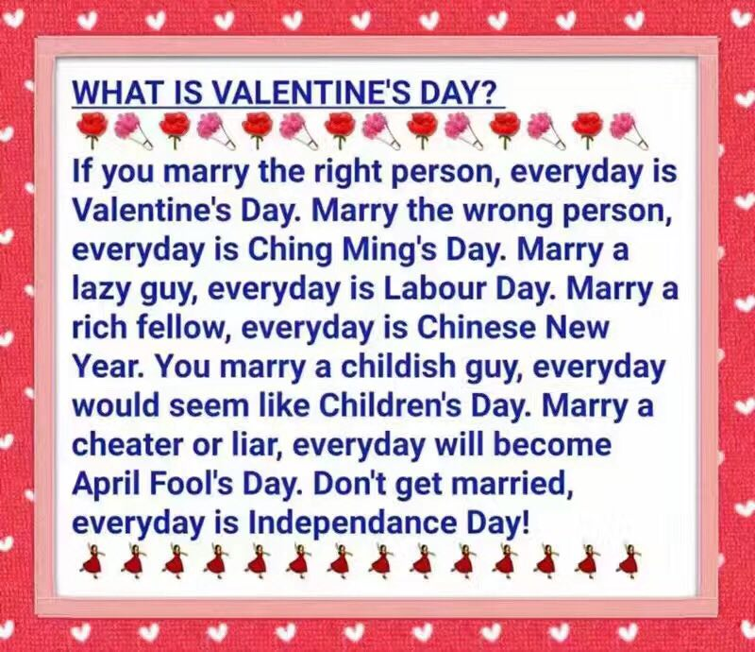
什么是情人节？
如果你和一个对的人结婚，每天都是情人节。
如果你和一个错的人结婚，每天都是清明节。
如果你和一个懒人结婚，每天都是劳动节。
如果你和一个有钱人结婚，每天都是春节。
如果你和一个孩子气的人结婚，每天都是儿童节。
如果你和一个骗子结婚，每天都是愚人节。
如果不结婚，每天都是独立日！

Slide 3
wòdǐ

Slide 4
生词（New Words）
臥底[wòdǐ]:spy
好人
描述[miáoshù]: to describe
懷疑(怀疑)[huáiyí]:
to doubt , to suspect

Slide 5
投票[tóupiào]: to vote
生词（New Words）
指[zhǐ]: to point at/to
出局[chūjú]: out; to knock out
结束[jiéshù]: to finish/end
继续[jìxù]: to continue

Slide 6
游戏规则 Game Rules [yóuxìguīzé]
Everyone will have a card with a word, but only one person (the spy) holds a different but relevant word. Keep your card a secret until the game end.
2. On each round , everyone describes the word on the card by using ONE sentence. You should try to give the clues to your partners but not be found by the spy.
3. After describing for a round, everyone needs to point to someone who you think is the spy. Who gets the most votes out.
4. If the spy get the most votes, the compere will declare "The spy lose!". But if after many turns and there are only 3 players alive (including the spy), then the spy wins.

Slide 7
https://www.youtube.com/watch?v=KvJbYSxw2Lw&index=20&list=PLwpv8T1mk-0NfJofFa1y4AJezmDa8HwIz
5’20” 手指、脚趾
https://www.youtube.com/watch?v=_neSkrKWzdU&index=4&list=PLwpv8T1mk-0NfJofFa1y4AJezmDa8HwIz
饺子包子（卧底直接出局）
https://www.youtube.com/watch?v=BvWTPC8Cq-Y
（眉毛/胡须 ；何炅/维嘉）

